Slide 1









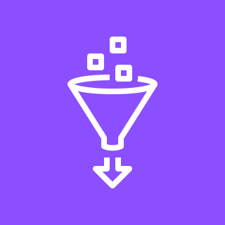
Virtual private cloud (VPC)
Availability Zone 1
Public subnet
Honey Pot
Volume
Bad Boys
Internet gateway
Private subnet
Data source connectors
Bucket
AWS Glue

